Slide 1
AASD 4016 – Full Stack Data Science Systems Final Project
PPE Compliance Detection
Group 4
Thien An Trinh
Roman Burekhin
Athira Devan
Narjes Amousoltani
Lester Azinge
Tina Khazaee
Kamryn Edwards

Slide 2
Agenda
Introduction
Problem
Methodology
Data
Inference
Images
Solution
Training
Models
Video
Demo
Local
Cloud
Benchmarking
mAP
speed
size
training time

Slide 3
Introduction
SAFETY
WORK
FAMILY
MANUAL TECHNIQUES
Labor-intensive
Error-prone
Unscalable
Regulatory infractions
Accidents
Legal liabilities

Slide 4
Introduction
SAFETY
WORK
FAMILY
AUTOMATED DETECTION
Continuous
Instant, real-time
Scalable
Regulatory infractions
Accidents
Legal liabilities

Slide 5
Methodology – ML Canvas

Slide 6

Methodology – Data
> 400 images
Labels:
HELMET
GLASSES
GLOVES
AUGMENTATION
>1200 images

Slide 7
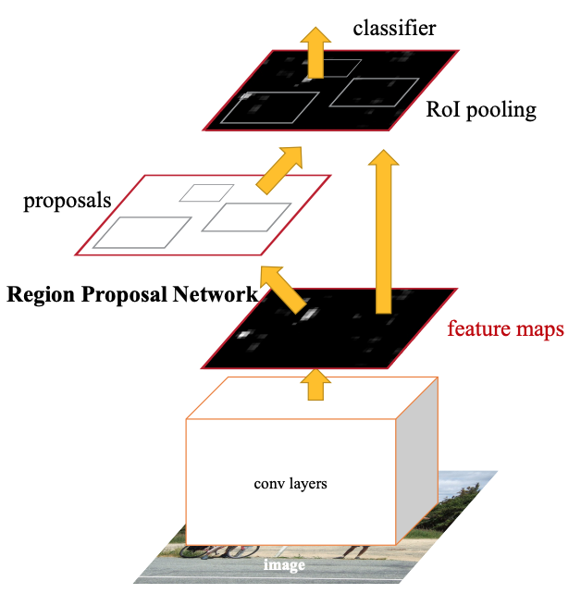
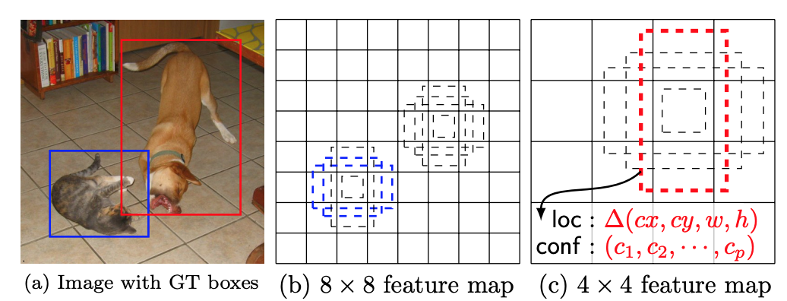

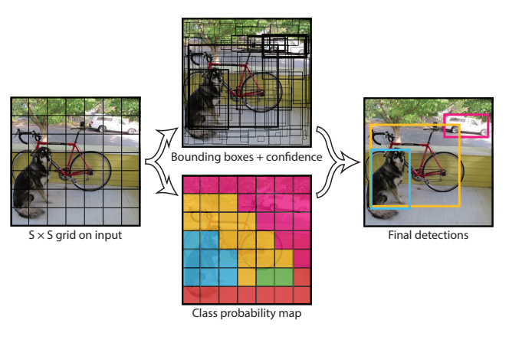
Methodology – Models
Faster R-CNN
SSD
YOLO
W. Liu et al., "SSD: Single Shot MultiBox Detector," p. arXiv:1512.02325doi: 10.48550/arXiv.1512.02325.
J. Redmon, S. Divvala, R. Girshick, and A. Farhadi, "You Only Look Once: Unified, Real-Time Object Detection," p. arXiv:1506.02640doi: 10.48550/arXiv.1506.02640.
J. Redmon and A. Farhadi, "YOLOv3: An Incremental Improvement," p. arXiv:1804.02767doi: 10.48550/arXiv.1804.02767.
S. Ren, K. He, R. Girshick, and J. Sun, "Faster R-CNN: Towards Real-Time Object Detection with Region Proposal Networks," p. arXiv:1506.01497doi: 10.48550/arXiv.1506.01497.

Slide 8
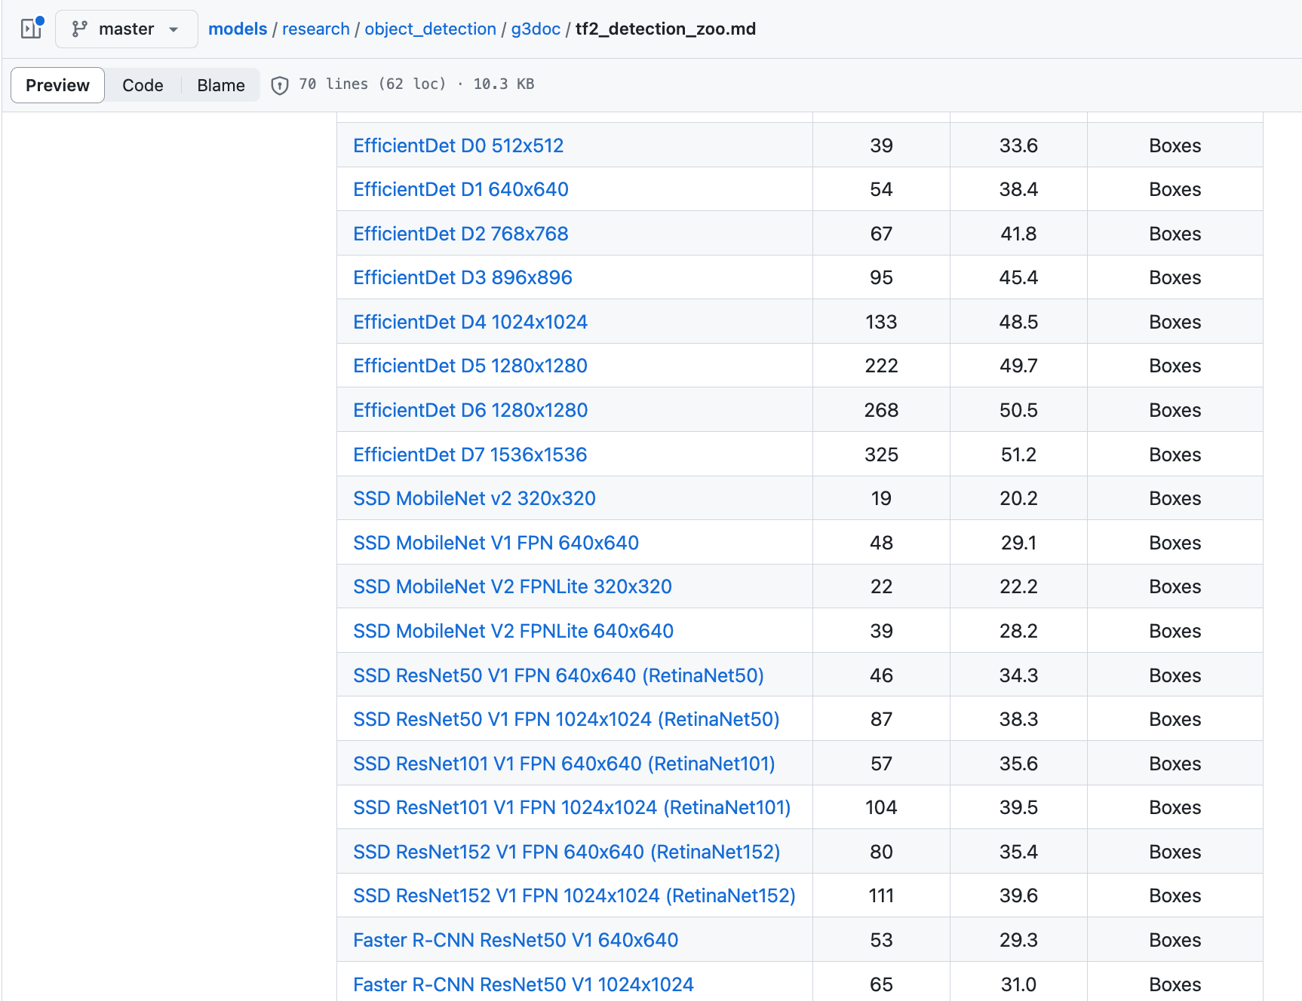
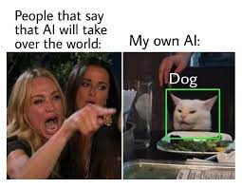
Methodology – TensorFlow OD
https://github.com/tensorflow/models/blob/master/research/object_detection/g3doc/tf2_detection_zoo.md

Slide 9

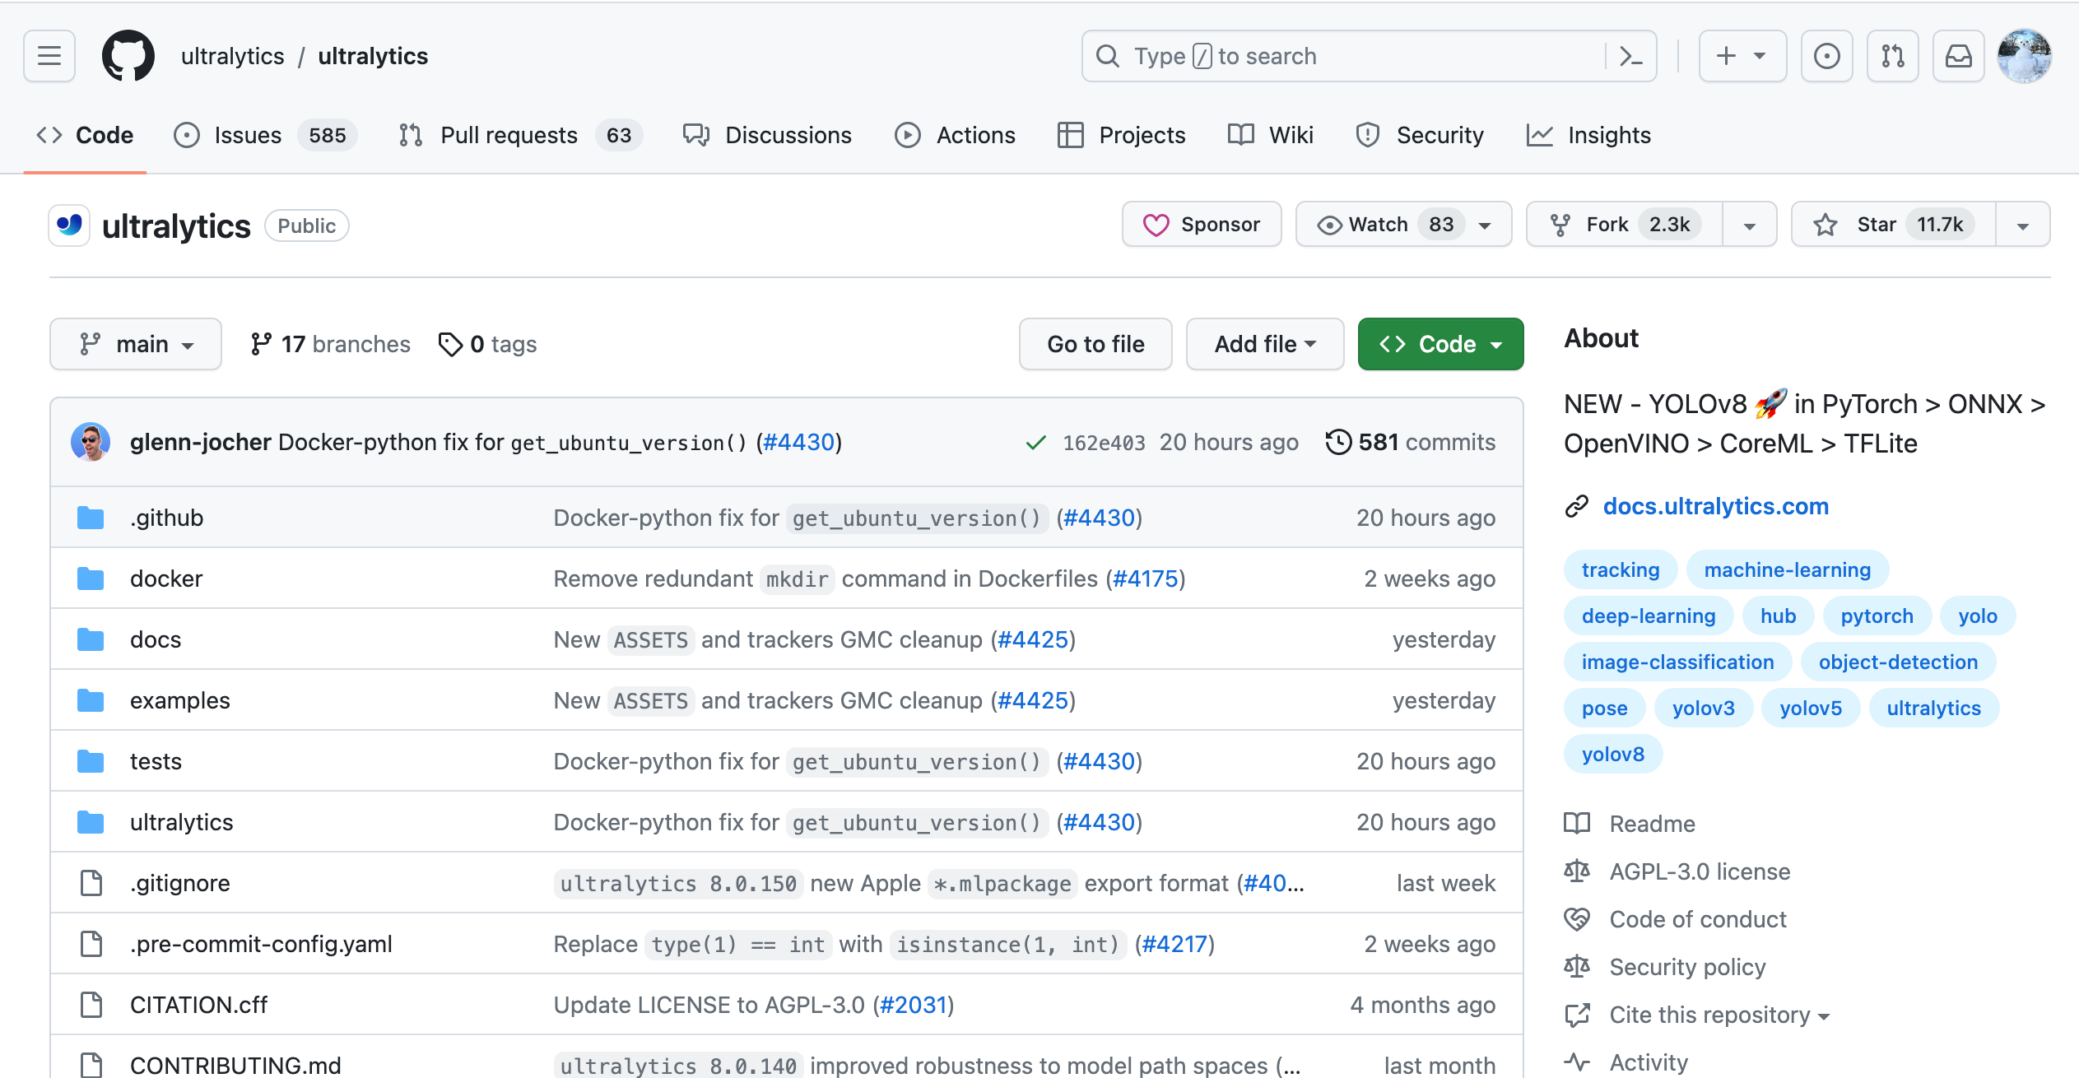
Methodology – YOLOv8
https://github.com/ultralytics/ultralytics

Slide 10


Methodology – Process
Annotate Data
Evaluate
Benchmark
Train Further
Deploy
Train
Select
30 epochs
mAP
Speed
Size
Training Time
200 epochs

Slide 11
Benchmarking
mAP
Yolov8n, Faster RCNN, Efficient DetD1 achieved comparable high scores.
SSD ResNet50 achieve attained the lowest precision.

Slide 12
Benchmarking
Speed
Yolov8n inference was the fastest.
Faster RCNN & SSD ResNet50 were the slowest.

Slide 13
Benchmarking
Size
Yolov8n size is the smallest.
SSD MobileNet and EfficientDet D1 are lighter compared to FasterRCNN and SSD Restnet50
⇒ They are optimized for size

Slide 14
Benchmarking
Training Time
Yolov8n took the shortest amount of time to train.
Second place is SSD MobileNet.

Slide 15
Benchmarking
 | YOLOv8n | SSD MobileNet FPN Lite | Faster R-CNN ResNet50 | EfficientDet D1 | SSD ResNet50
mAP | ✔︎ |  | ✔︎ | ✔︎
Speed | ✔︎✔︎ | ✔︎
Size | ✔︎︎︎︎︎✔︎ | ✔︎ |  | ✔︎
Training Time | ✔︎✔︎ | ✔︎

Slide 16
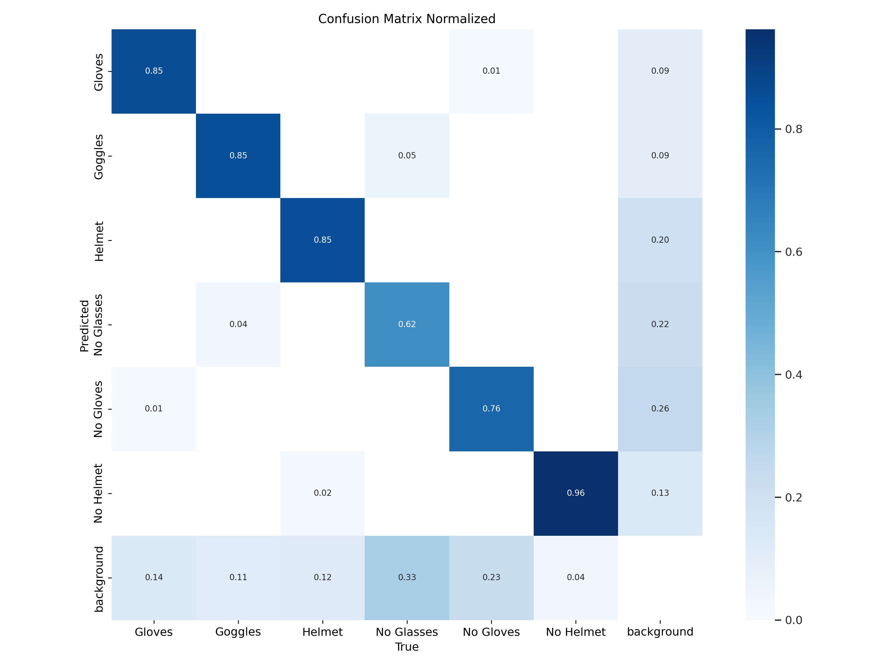
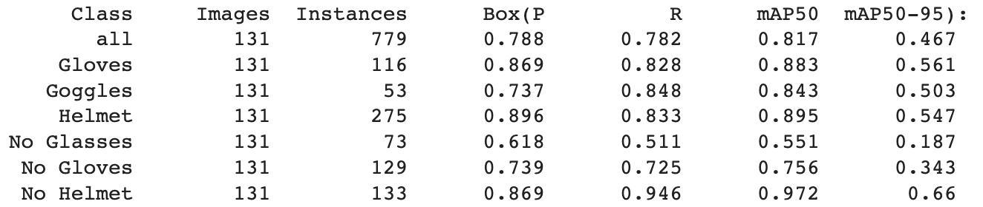
Further Training

Slide 17
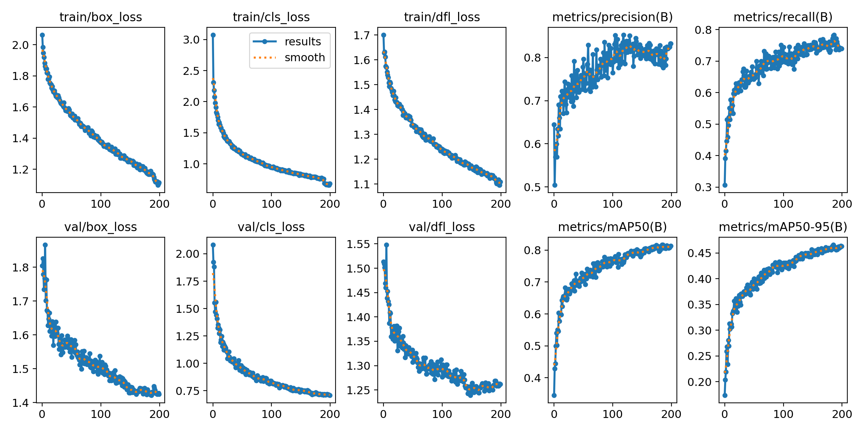
Further Training
There is still room for further training.

Slide 18
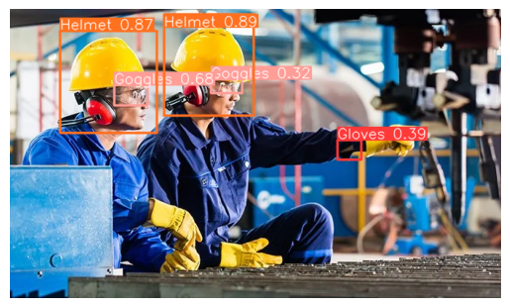
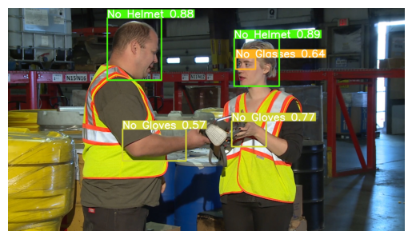
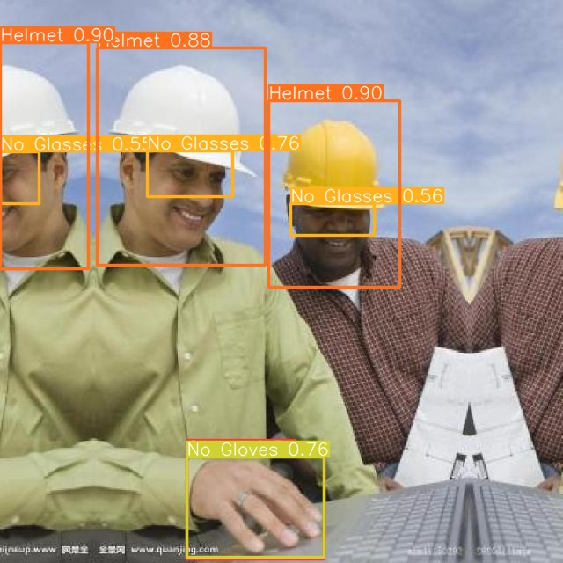
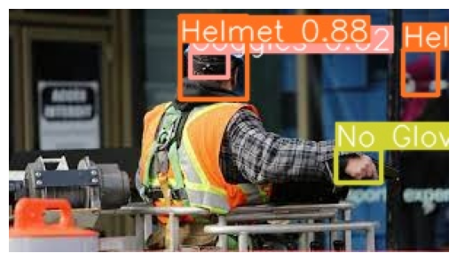
Inference – Images

Slide 19
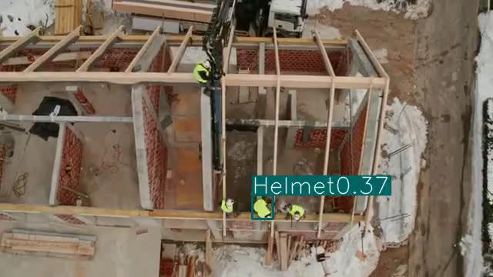
Inference – Video

Slide 20



Demo

Slide 21

Demo – AWS

Slide 22
Thank you!

